Slide 1
Final Engagement
Attack, Defense & Analysis of a Vulnerable Network

Slide 2
Table of Contents
This document contains the following resources:
Network Topology & Critical Vulnerabilities
Alerts Implemented
Hardening
Offensive Actions

Slide 3

Network Topology
& Critical Vulnerabilities
‹#›

Slide 4
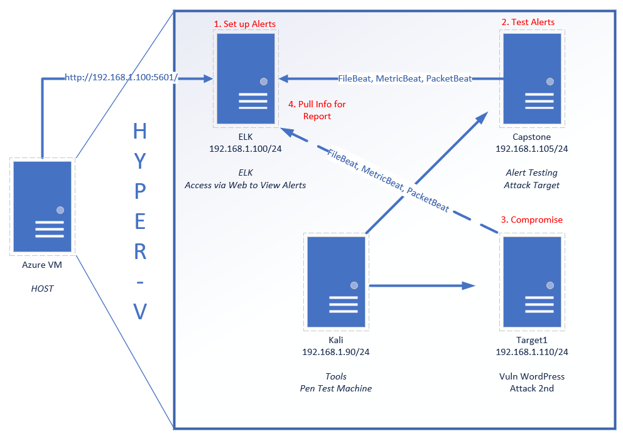
Network Topology
Network
Address Range: 192.168.1.0/24
Netmask: 255.255.255.0
Gateway: 192.168.1.1
Machines
IPv4: 192.168.1.100
OS: Linux
Hostname: ELK
IPv4: 192.168.1.105
OS: Linux
Hostname: Capstone
IPv4: 192.168.1.90
OS: Kali Linux
Hostname: Kali
IPv4: 192.168.1.110
OS: Linux
Hostname: Target 1

Slide 5
Critical Vulnerabilities: Target 1
Our assessment uncovered the following critical vulnerabilities in Target 1.
Vulnerability | Description | Impact
Brute Force | Web site is vulnerable to brute force attacks | Was able to crack multiple passwords
Insecure Configuration Files | Configuration Files are easily accessible | Database passwords were retrieved from insecure config files
Password Policy | Users are using weak passwords that are easily crackable | Were able to guess or brute force several passwords

Slide 6
Alerts Implemented
‹#›

Slide 7
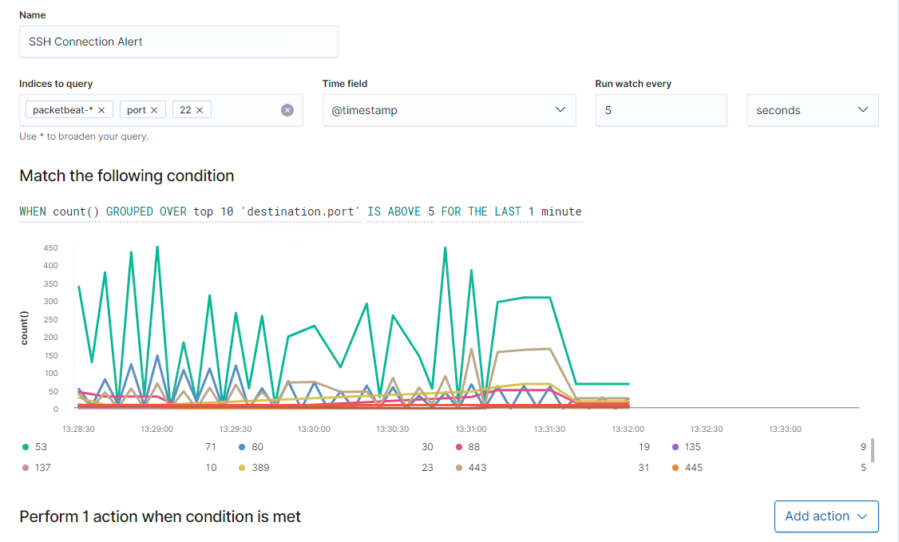
SSH connection alert

Slide 8
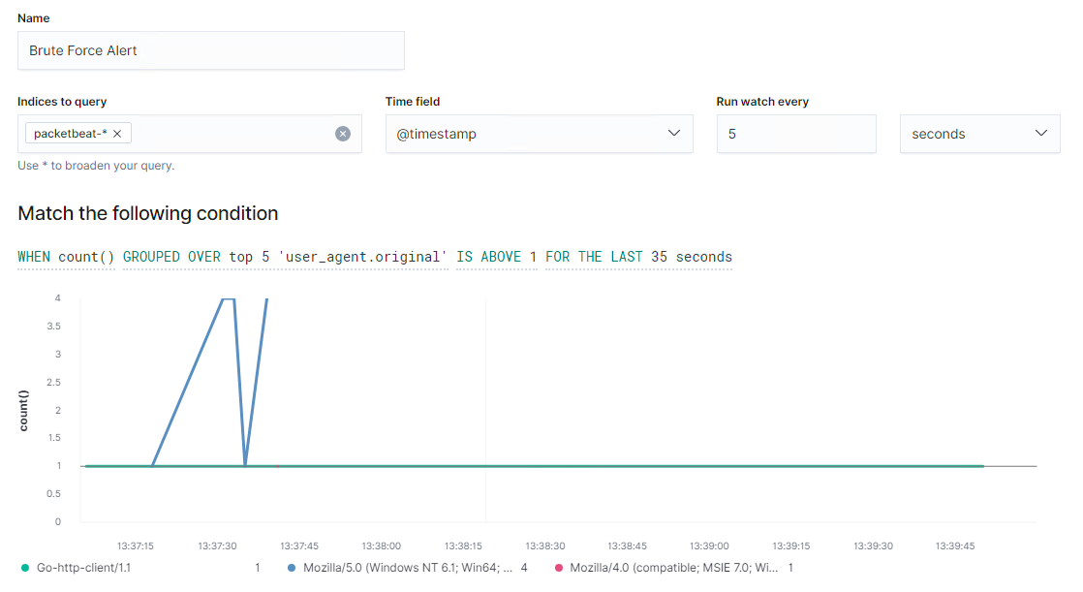
Brute Force Alert

Slide 9
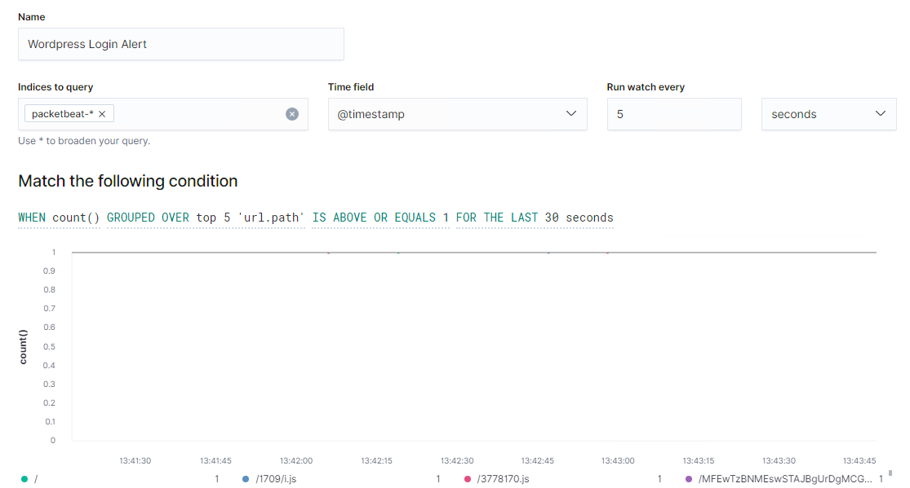
Wordpress login alert

Slide 10
Hardening
‹#›

Slide 11
Hardening Against Brute Force Attack on Target 1
To harden the target against brute force attacks the following steps can be taken
Implement alerts in SIEM system (kabana) so that excessive failed login attempts can be identified quickly.
Limit Logins to specified IP range
Change the default port used for ssh from 22 to another port.
Implement a strong password policy

Slide 12
Hardening Against Insecure Config Files on Target 1
Insecure config files can be better protected by the following:-
Limit access to the file to only a few specified users by changing the permissions
Add password protection to the file.
hide the wp-config.php file by changing its location

Slide 13
Hardening Against Password cracking on Target 1
Weak passwords were key to the attacks on target 1 which could be better protected as follows:
Ensure a robust password policy is put into place which includes:
specify the complexity level required for all passwords
lockout after failed login attempts
compulsory periodic password changes

Slide 14
Offensive Actions
‹#›

Slide 15
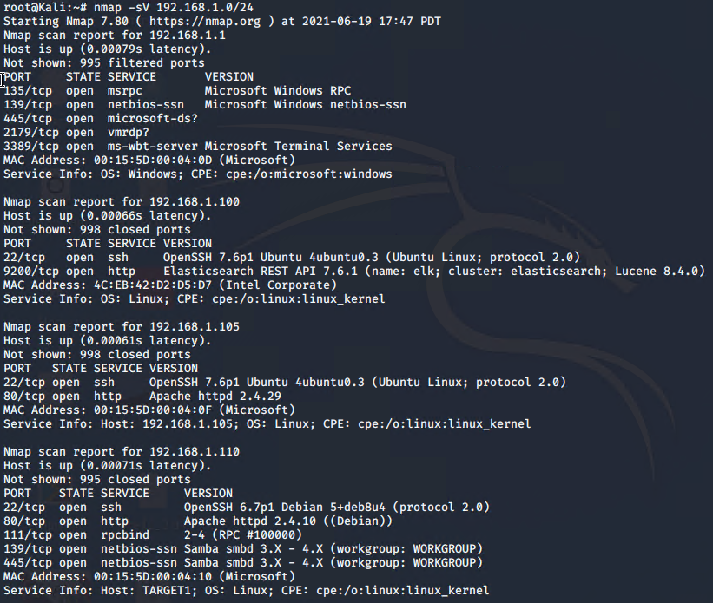
Exposed Services
NMAP Scan was used to identify target and open ports and services.

Slide 16
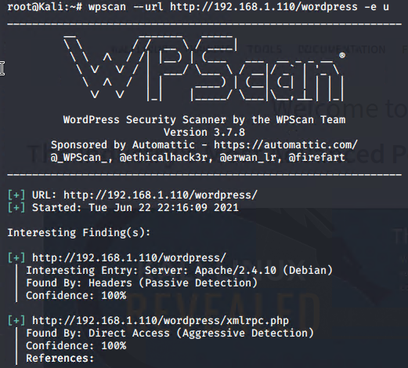
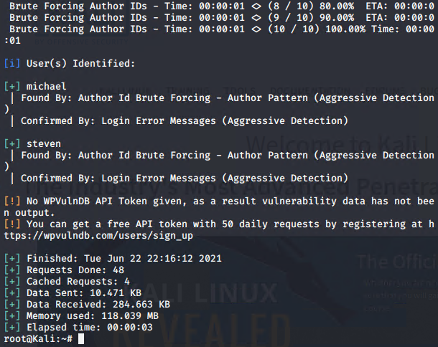
Finding User Names
Using WPScan to enumerate Wordpress users
michael and steven were both identified as users

Slide 17
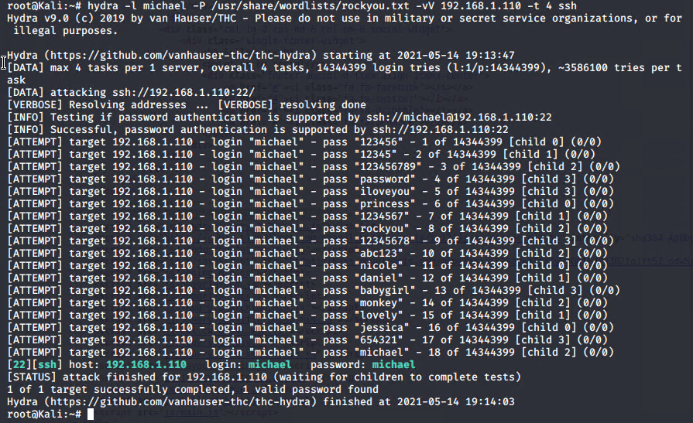
Cracking SSH password
Hydra was used to discover michaels password
Note the weak password used by michael

Slide 18
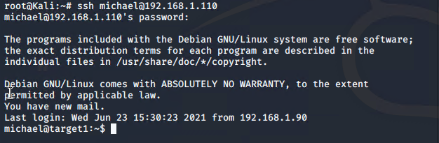
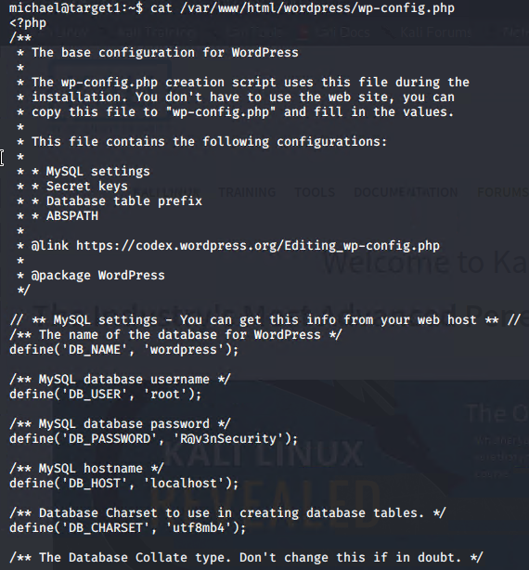
Login as michael using ssh and opening wp_config.php
Password details for access to mysql database are contained in the wp_config.php file.

Slide 19
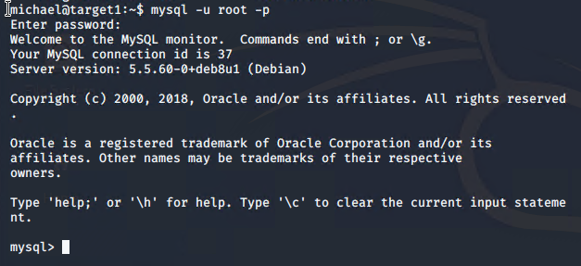
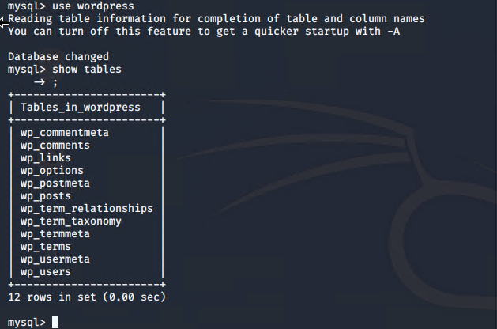
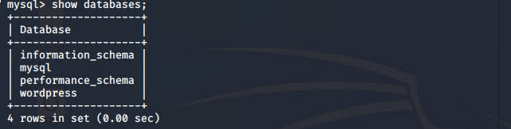
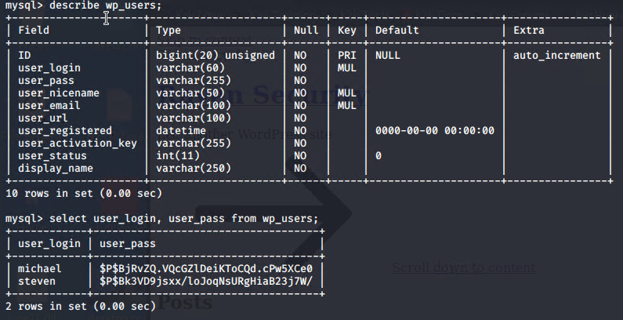
Accessing the Wordpress Database
Password hashes obtained from wp_users

Slide 20
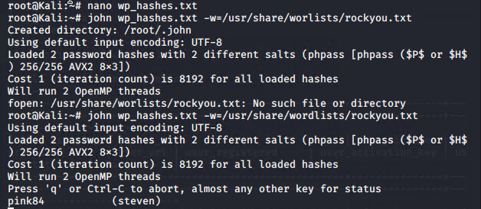
Cracking the password for steven
Password hashes were written into a file ‘wp_hashes.txt’ and cracked using John the ripper

Slide 21
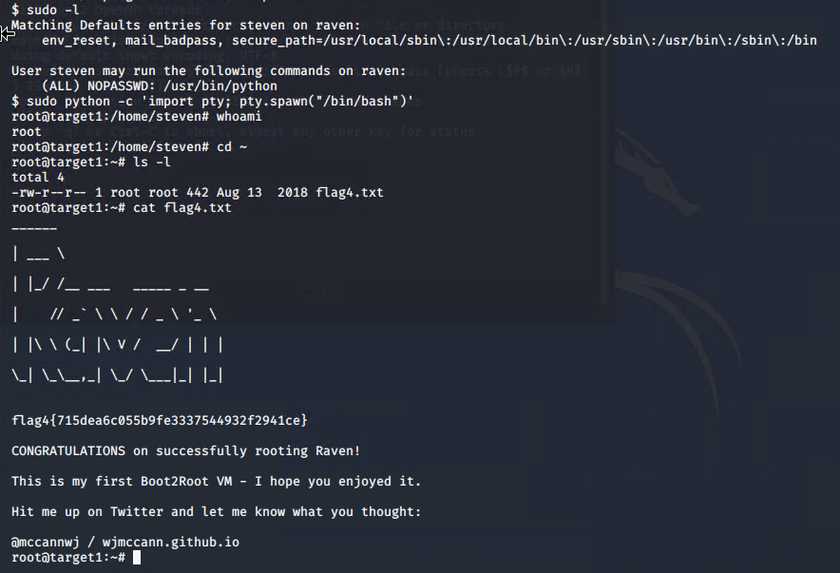
Gaining Root access (and flag4)
Logging on as steven we find that he is able to run python using sudo. A bash shell with root privileges can be opened as shown.

Slide 22
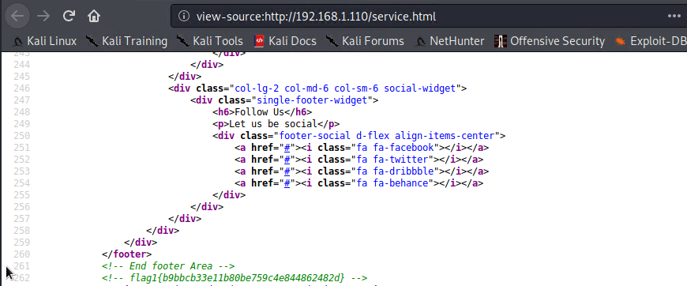
Other Flag locations
Note: flag1 can be found by either viewing source code on the web page (service.html - line 262) or by opening the file in /var/www/html/service.html.
“nano /var/www/html/service.html”

Slide 23
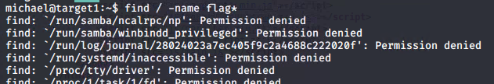
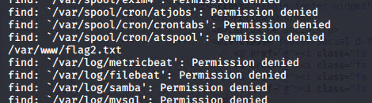
Other Flag locations

Slide 24
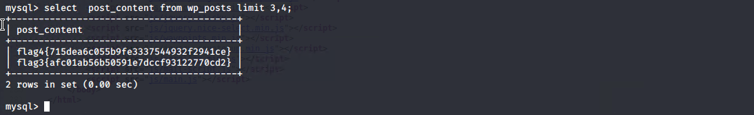
Other Flag locations

